Slide 1
E6156 – Topics in SW Engineering (F23) Cloud Computing Lecture 11: GraphQL, CI/CD
© Donald F. Ferguson, 2023

Slide 2

Course Checkpoint
2 | E6156 – Topics in SW Engineering: Cloud Computing: Lecture 10: Design Patters, DynamoDB, Composition © Donald F. Ferguson, 2023

Slide 3
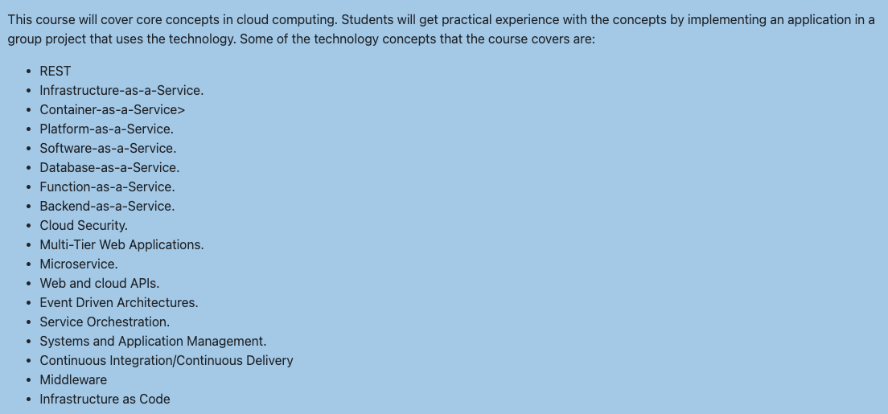
Status
We have “covered” most of the basic concepts.
We should “focus” on project completion.
I want to introduce four concepts:
GraphQL
Middleware
CI/CD
Infrastructure as Code
Have your projects do something very simple.

Slide 4
GraphQL
4 | E6156 – Topics in SW Engineering: Cloud Computing: Lecture 10: Design Patters, DynamoDB, Composition © Donald F. Ferguson, 2023

Slide 5
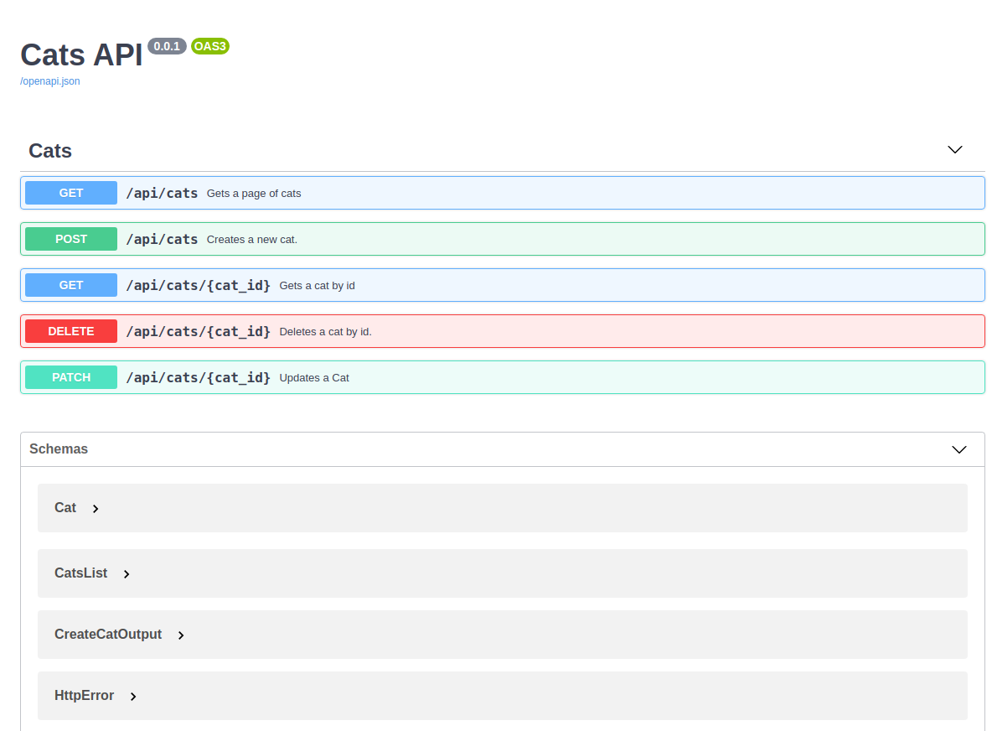

Overview
REST
Serves document API
Client uses documented paths, methods, …
Resources (Data) are like a HTML document.
GraphQL
Service documents resource model/schema
Client uses queries and updates (mutations).
Resources are like a (graph) database.
REST API
Discover API
Client
Use API
Discover Schema
Resource Graph
Client
Query Update Data

Slide 6
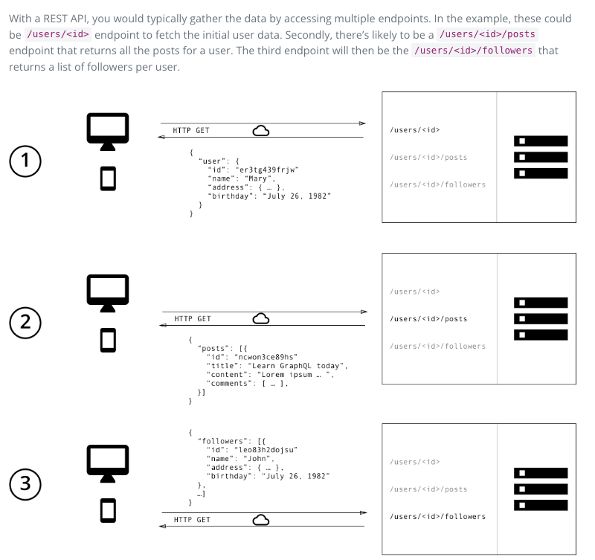
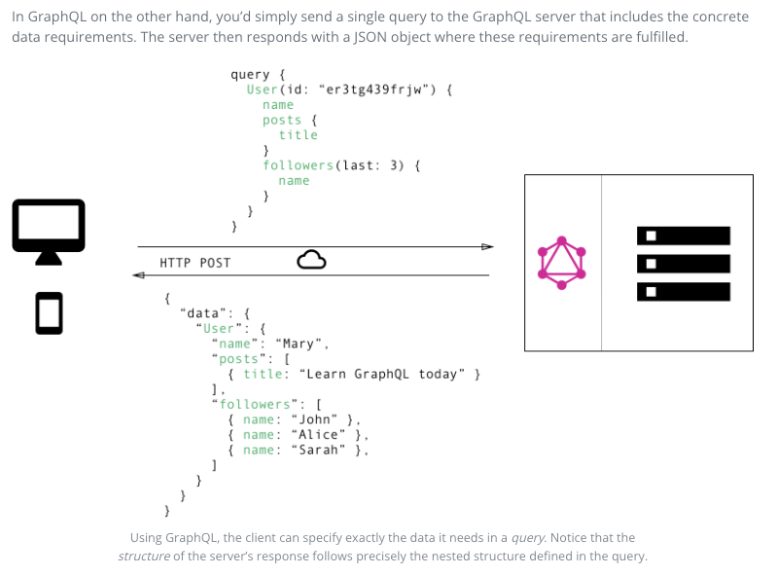
REST vs GraphQL (https://www.howtographql.com/basics/1-graphql-is-the-better-rest/)
Consider getting summary info from /users/{id}, /users/{id}/posts, /users/{id}/followers

Slide 7
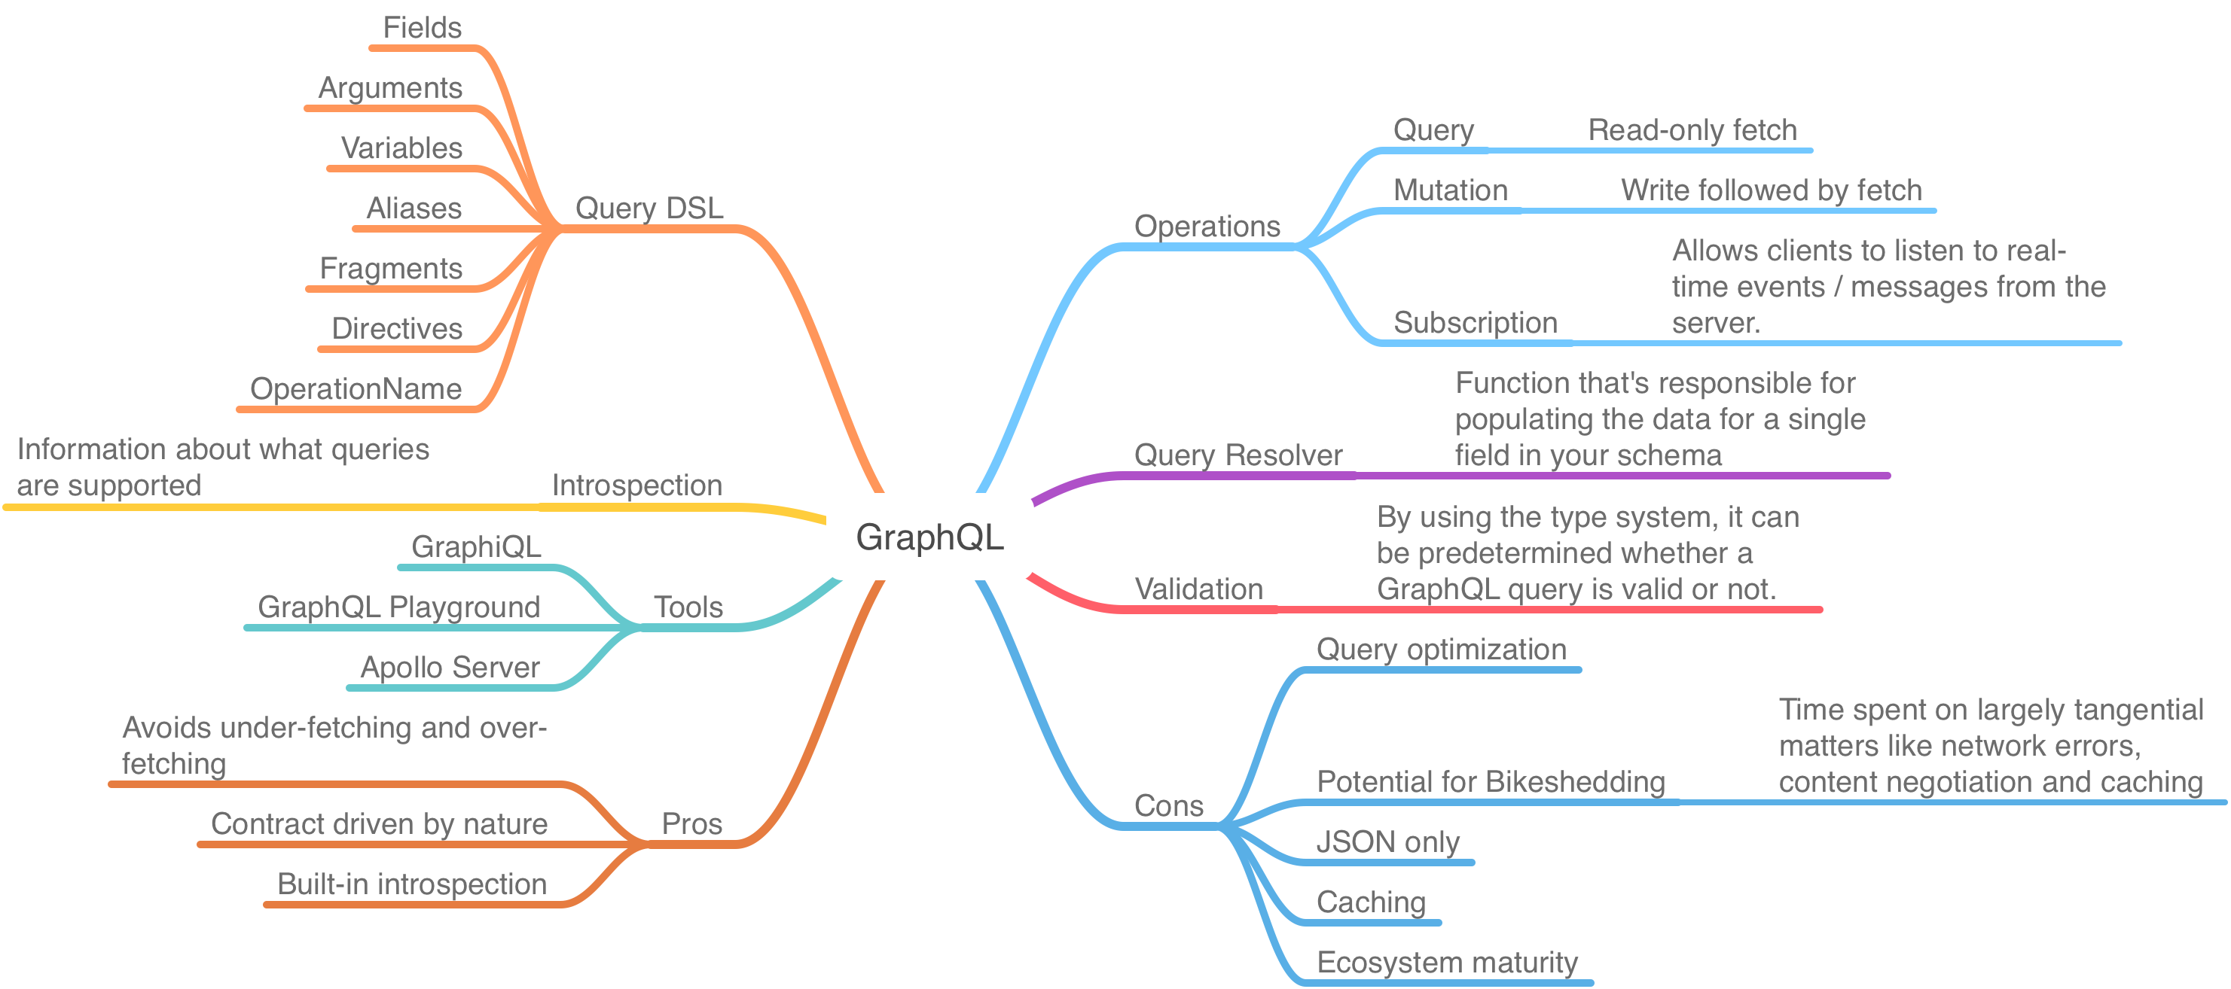
Some GraphQL Concepts (https://www.peerislands.io/how-to-use-graphql-to-build-bffs/)

Slide 8
REST and GraphQL Summary
Some resources:
A good, online playground with data: https://andybek.com/gql-nba
The Python GraphQL community on GitHub (https://github.com/graphql-python)
Go on GitHub (https://github.com/topics/graphql?l=go)
This lecture uses Python and Graphene
https://docs.graphene-python.org/en/latest/quickstart/
FastAPI and GraphQL example:
https://github.com/danieldanuega/fastapi-graphql
Created a GitHub project from template.
Search tag on my hard drive is “#fastapi-graphql-1”
On GitHub: https://github.com/donald-f-ferguson/fastapi-graphql-example.git); used Docker compose version.
Created a Codespace from the templates.

Slide 9
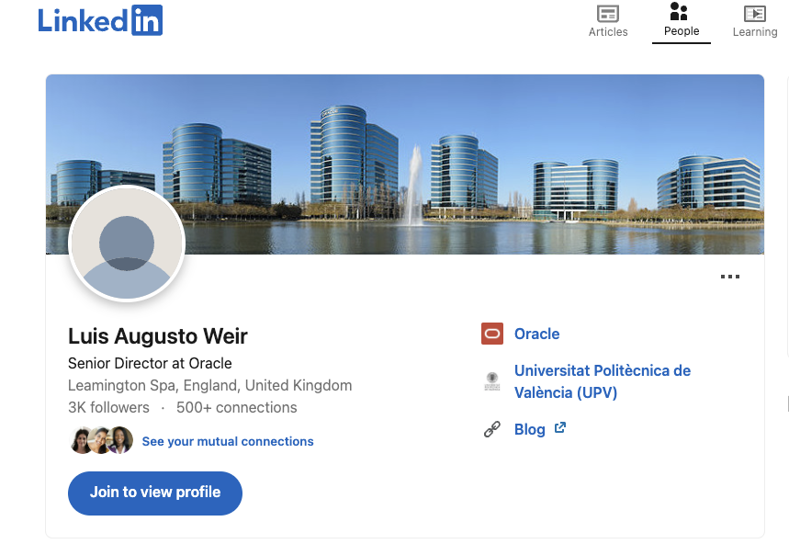
Stolen Overview
https://uk.linkedin.com/in/lweir
Switch to PDF

Slide 10
Middleware
10 | E6156 – Topics in SW Engineering: Cloud Computing: Lecture 10: Design Patters, DynamoDB, Composition © Donald F. Ferguson, 2023

Slide 11
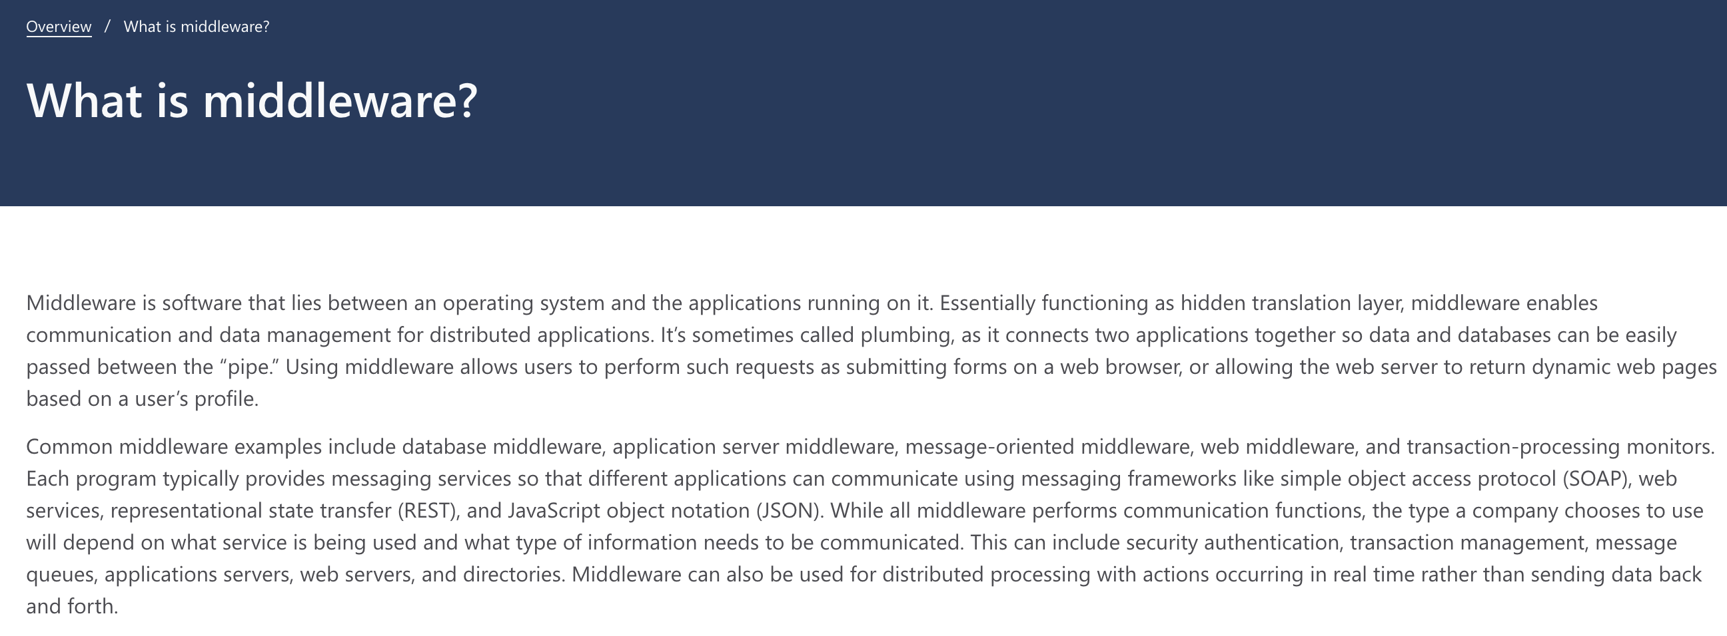
Middleware

Slide 12
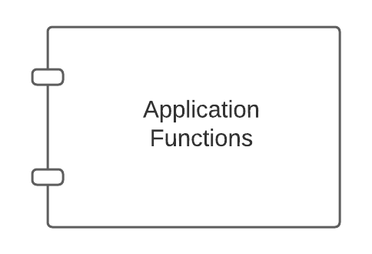
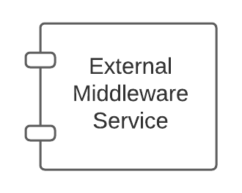
Middleware – Conceptual Model
Middleware:
Application might call directly, e.g. DB
May be implicitly called as part of request processing, e.g. logging.

Slide 13
Middleware – Conceptual Model
This is another example of
Single responsibility
Separation of Concerns
Being a good application logic developer and a good middleware developer are different roles, skill sets, … …
Also an example of the
Closed for modification, but
Open for extension
Middleware:
Application might call directly, e.g. DB
May be implicitly called as part of request processing, e.g. logging.

Slide 14
FastAPI Middleware (https://medium.com/@saverio3107/mastering-middleware-in-fastapi-from-basic-implementation-to-route-based-strategies-d62eff6b5463)
What Does Middleware Do?
Incoming Request: When a request comes in, the middleware can examine and even modify parts of the request like cookies, headers, query parameters, etc., before it reaches the actual API service method. For example, it can validate the request, authenticate the user, or log the request details.
Outgoing Response: After the API service method has processed the request and generated a response, the middleware gets a chance to inspect and modify the response before it goes back to the client. This can include things like changing the response headers, transforming the content, and so on.

Slide 15
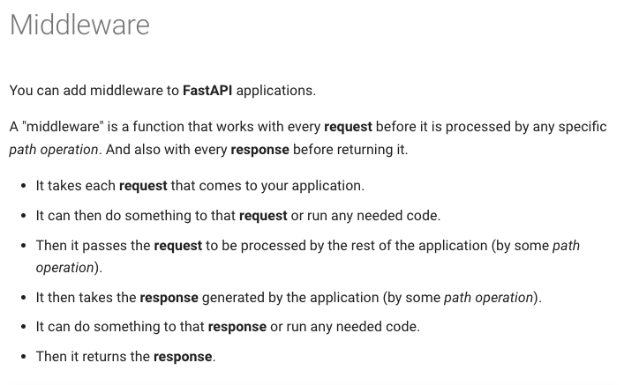
FastAPI Middleware
https://fastapi.tiangolo.com/tutorial/middleware/
https://fastapi.tiangolo.com/advanced/middleware/

Slide 16
Example
Walk through Medium Article
https://medium.com/@saverio3107/mastering-middleware-in-fastapi-from-basic-implementation-to-route-based-strategies-d62eff6b5463
This is the very simple version. There is a more sophisticated approach to middleware in FastAPI. https://fastapi.tiangolo.com/advanced/middleware/

Slide 17
CI/CD
17 | E6156 – Topics in SW Engineering: Cloud Computing: Lecture 10: Design Patters, DynamoDB, Composition © Donald F. Ferguson, 2023

Slide 18
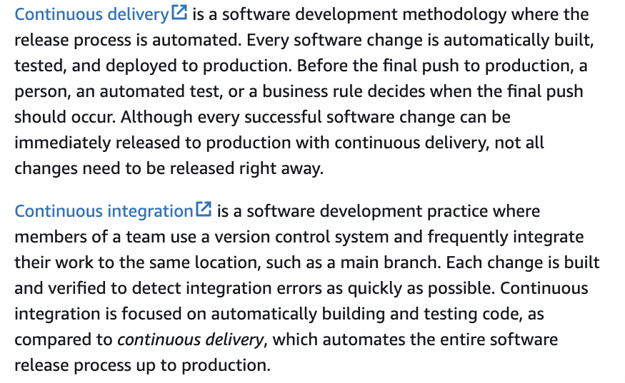
CI/CD (Part of DevOps)

Slide 19
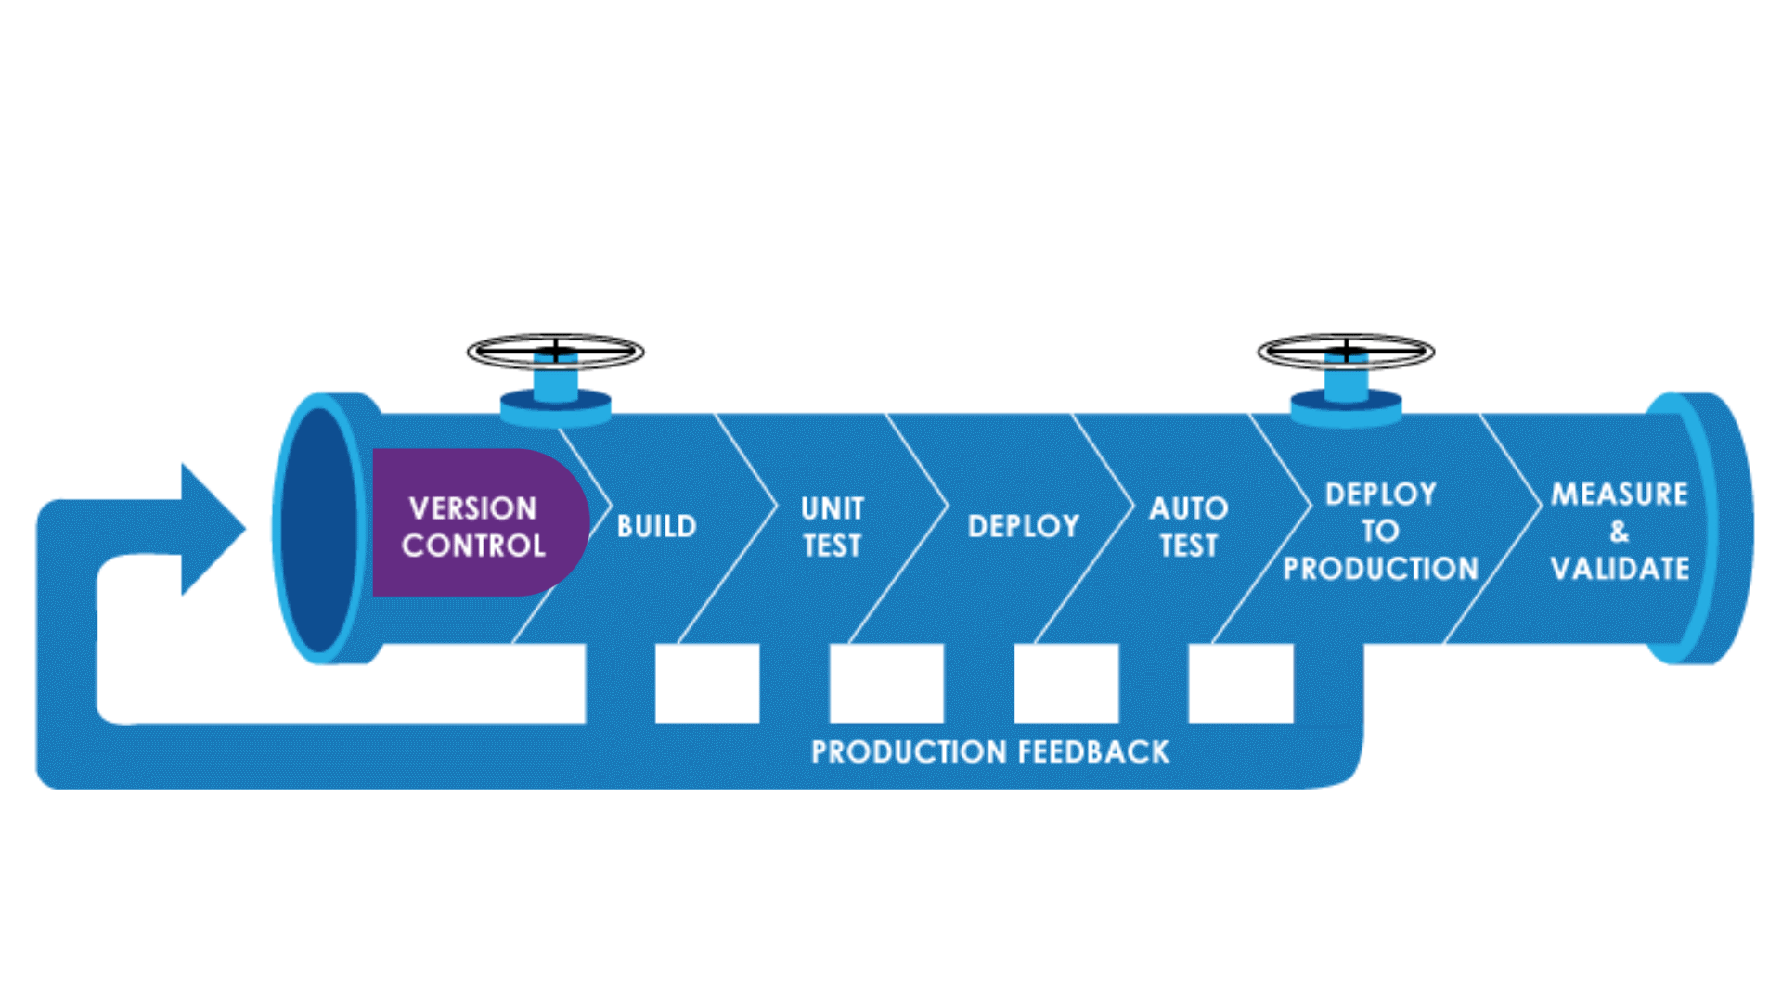
CI/CD Pipeline
https://medium.com/jaanvi/basics-of-ci-cd-pipeline-5762e0eca44e

Slide 20
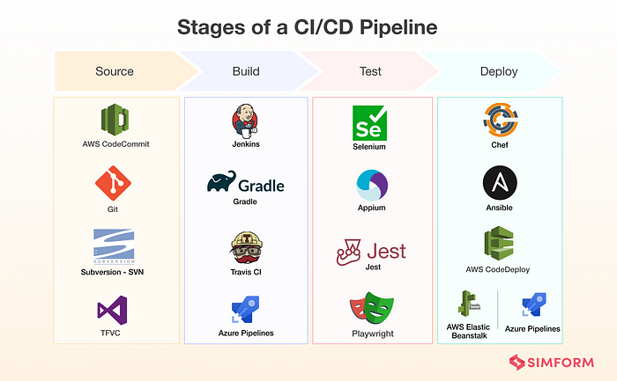
Some Technologies

Slide 21
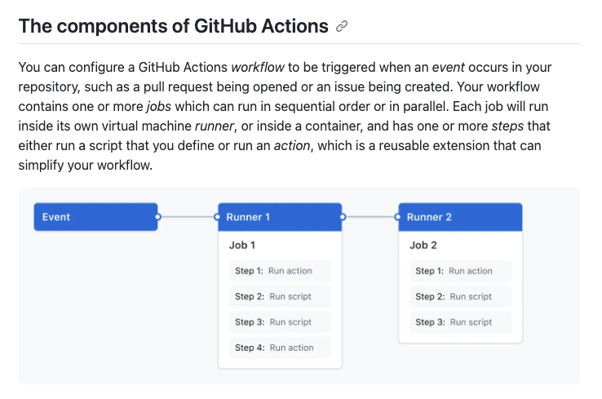
GitHub Actions

Slide 22
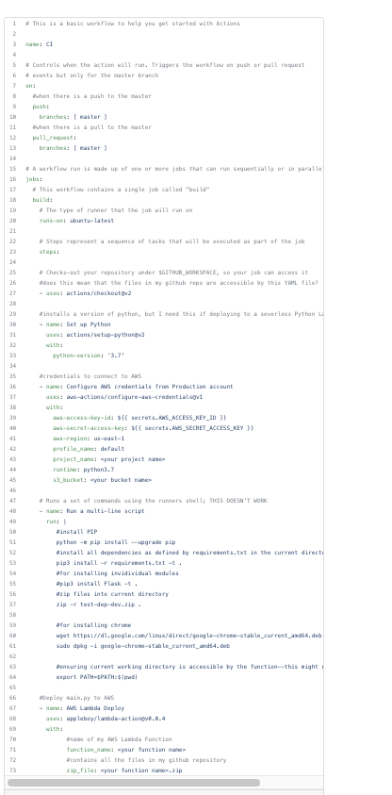
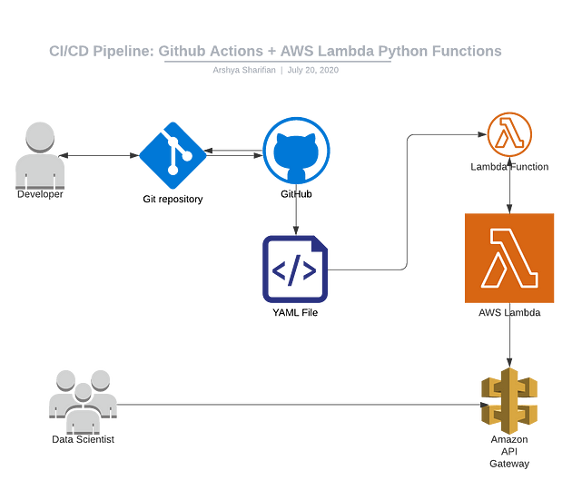
Simple Example with GitHub Actions
https://towardsdatascience.com/modern-ci-cd-pipeline-git-actions-with-aws-lambda-serverless-python-functions-and-api-gateway-9ef20b3ef64a

Slide 23
Infrastructure as Code
23 | E6156 – Topics in SW Engineering: Cloud Computing: Lecture 10: Design Patters, DynamoDB, Composition © Donald F. Ferguson, 2023

Slide 24
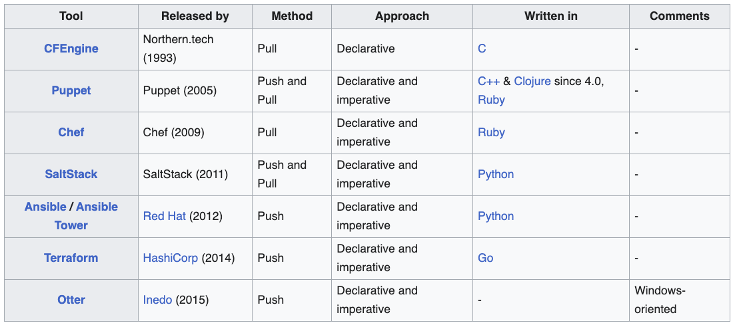
Infrastructure as Code
“Infrastructure as code (IaC) is the process of managing and provisioning computer data center resources through machine-readable definition files, rather than physical hardware configuration or interactive configuration tools.” (https://en.wikipedia.org/wiki/Infrastructure_as_code)
Code can be:
Procedural/Declarative
Push/Pull

Slide 25
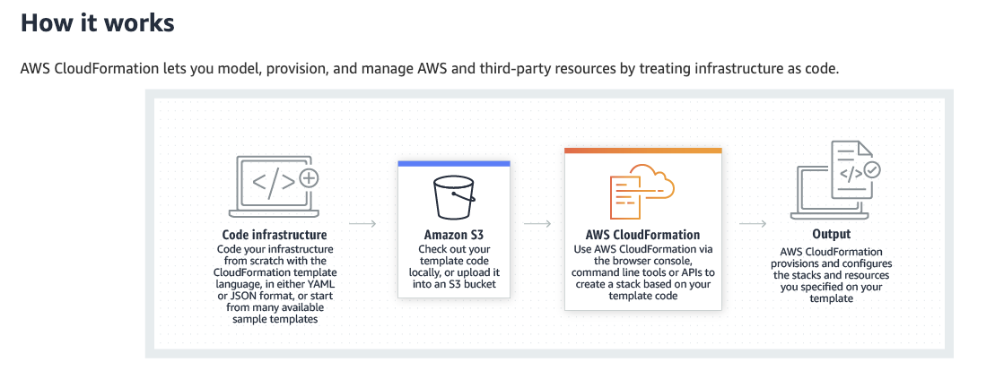
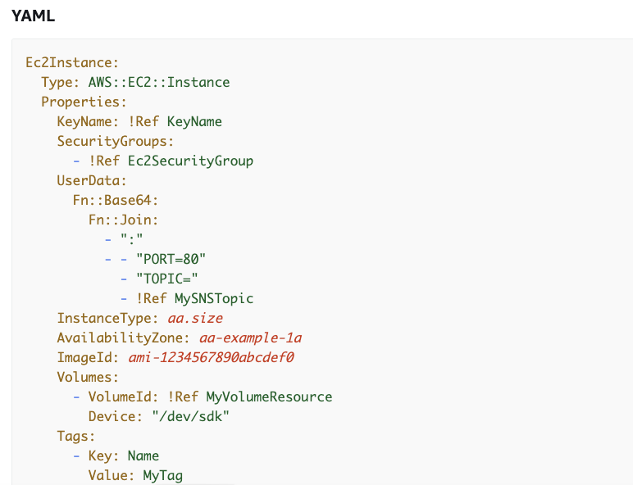
CloudFormation
AWS CloudFormation simplifies provisioning and management on AWS. You can create templates for the service or application architectures you want and have AWS CloudFormation use those templates for quick and reliable provisioning of the services or applications (called “stacks”). You can also easily update or replicate the stacks as needed.
One role (“admin”) creates templates that are well-designed, comply with policies, etc.
“User” instantiation a template to produce infrastructure by specifying values for variables.

Slide 26
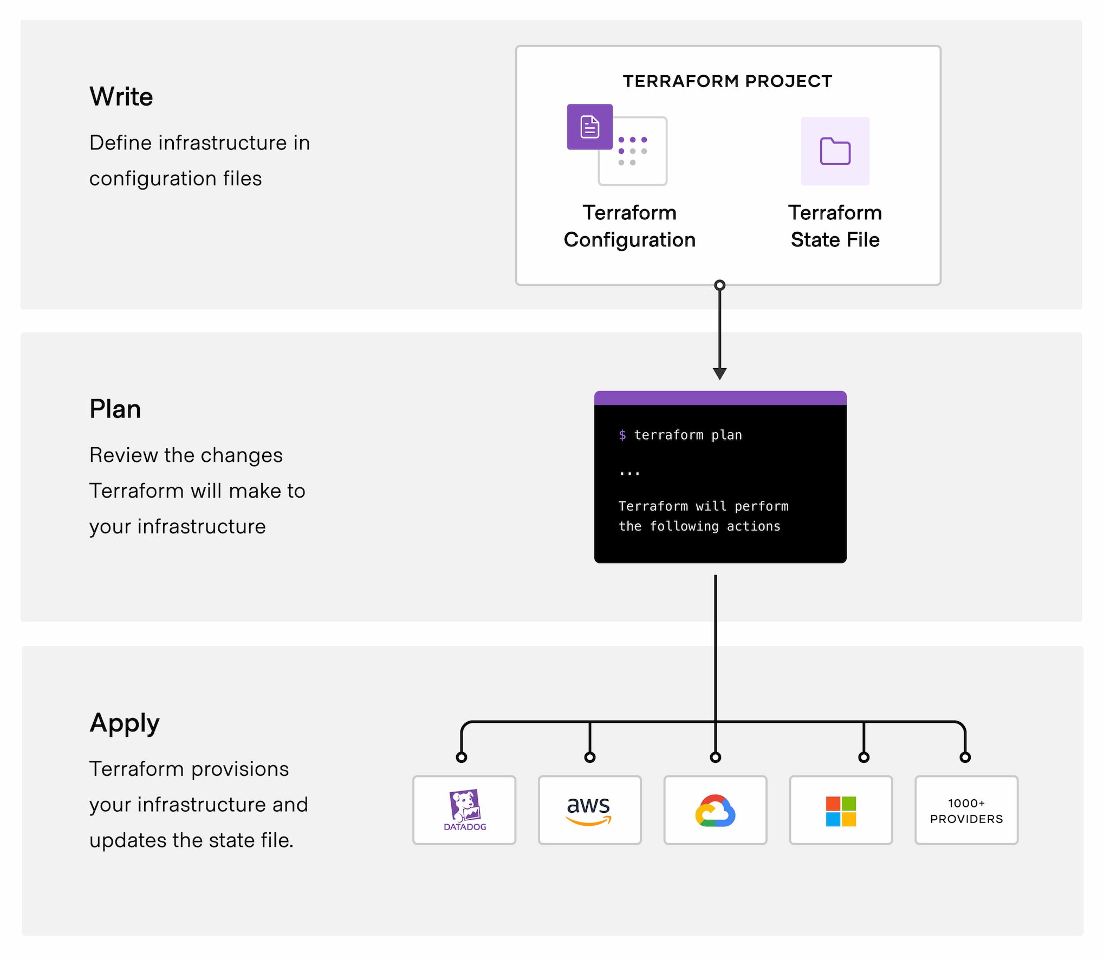
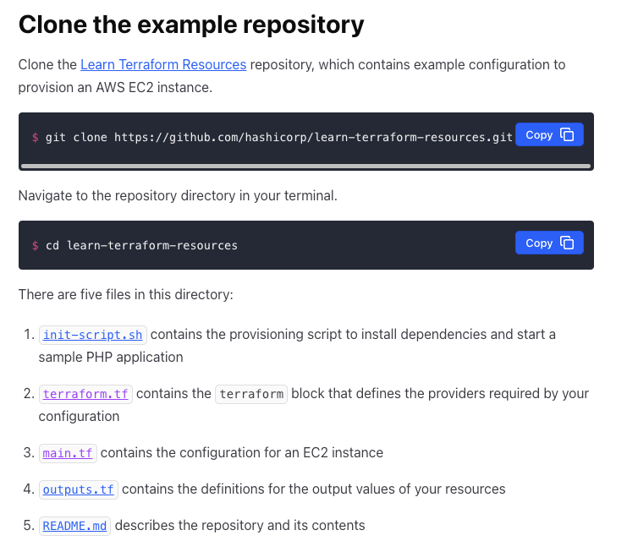
Terraform
https://developer.hashicorp.com/terraform/tutorials/configuration-language/resource#main-tf

Slide 27
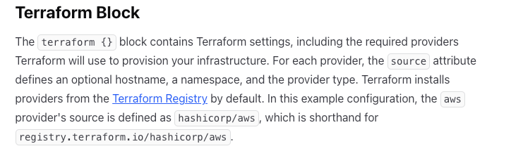
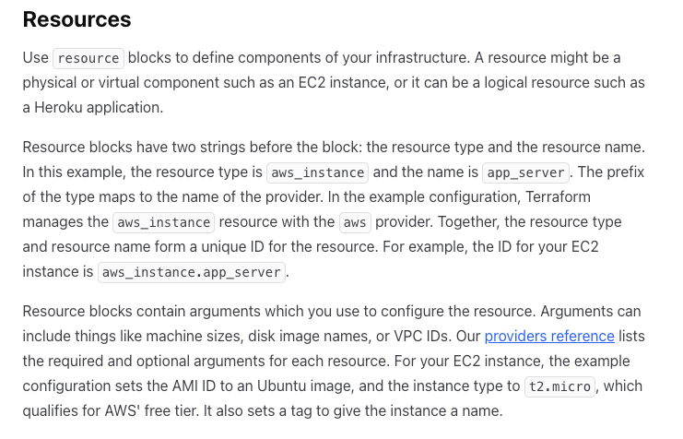
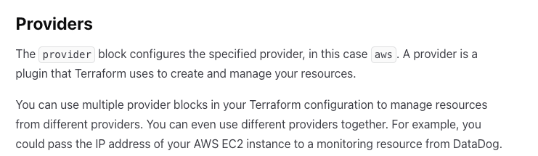
Terraform Example
https://developer.hashicorp.com/terraform/tutorials/aws-get-started/aws-build
terraform {
required_providers {
aws = {
source = "hashicorp/aws"
version = "~> 4.16"
}
}
required_version = ">= 1.2.0"
}
provider "aws" {
region = "us-west-2"
}
resource "aws_instance" "app_server" {
ami = "ami-830c94e3"
instance_type = "t2.micro"
tags = {
Name = "ExampleAppServerInstance"
}
}

